Slide 1
Search in Complex Environment
Dr. Iftikhar Alam
CUSIT

Slide 2
Recap
Chapter 3. Fully observable, deterministic, static, known
environments where the solution is a sequence of actions.
Local Search and Optimization Problems
Local search algorithms operate by searching from a start state to neighboring states, without keeping track of the paths, nor the set of states that have been reached.

Slide 3
Cont…
Not systematic
Two key advantages:
  (1) they use very little
  memory; and
  (2) they can often find reasonable solutions in large or infinite state spaces for
  which systematic algorithms are unsuitable.
Local search algorithms can also solve optimization problems, in which the aim is to find the best state. For example 4-queen problem, 8-queen problem

Slide 4
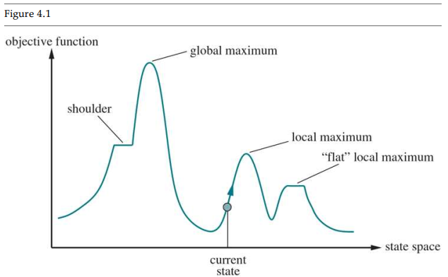
Hill-climbing search
Local search algorithm
Greedy approach
No back tracking

Slide 5
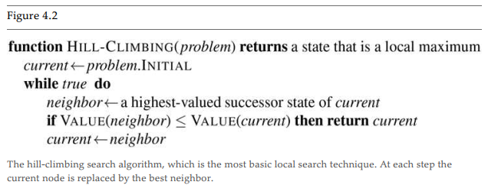
Cont…
It keeps track of one current state and on each iteration moves to the neighboring state with highest value—that is, it heads in the direction that provides the steepest ascent.

Slide 6
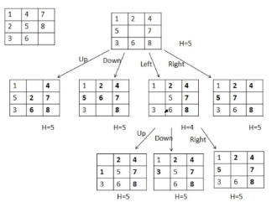
8-Puzzle problem

Slide 7
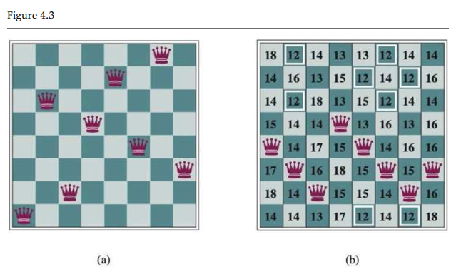
8-queen problem using hill climbing

Slide 8
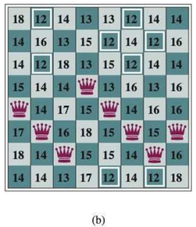
Cont…
Cost: An 8-queens state with heuristic cost
estimate h=17.(Direct attack or indirect attacks)
There are 8 moves that are tied for best,
  with h=12

Slide 9
Problems in Hill climbing
Local maximum (local information) blind folded
Plateau/Flat maximum
Ridge

Slide 10
Point to be noted
Starting from a randomly generated 8-queens state, steepest-ascent hill climbing gets stuck 86% of the time, solving only 14% of problem instances.
On the other hand, it works quickly, taking just 4 steps on average when it succeeds and 3 when it gets stuck—not bad for a state space
with million states. 88 ≈ 17

Slide 11
Local beam search
Beam width in Hill climbing algo (beta value) = 1
It will keep in memory based on beam width to overcome the issues in hill climbing greedy techniques, where the beam width was only one.

Slide 12
Evolutionary algorithms
An evolutionary algorithm (EA) is an algorithm that uses mechanisms inspired by nature and solves problems through processes that emulate the behaviors of living organisms.
There is a population of individuals (states), in which the fittest (highest value) individuals produce offspring (successor states) that populate the next generation, a process called recombination.
Genetic Algorithm (inspired from biology)
Particle swarm optimization (PSO)

Slide 13
Genetic Algorithm
Abstract concept
Used for solving complex problems (link NP problems)
  A problem is called NP (nondeterministic polynomial) if its solution can be guessed and verified in polynomial time.
Focus on optimization
Repeated steps
  Population, fitness, selection, crossover, mutation

Slide 14
Cont…
Population (collection of states)
Fitness( algo: closest to final solution, no of non attacking pairs)
Selection ( selecting state that are close to final solution, roulette wheel, rank, etc)
Crossover (interchanging values for best solution )
mutation (random changes to make it mutant)

Slide 15
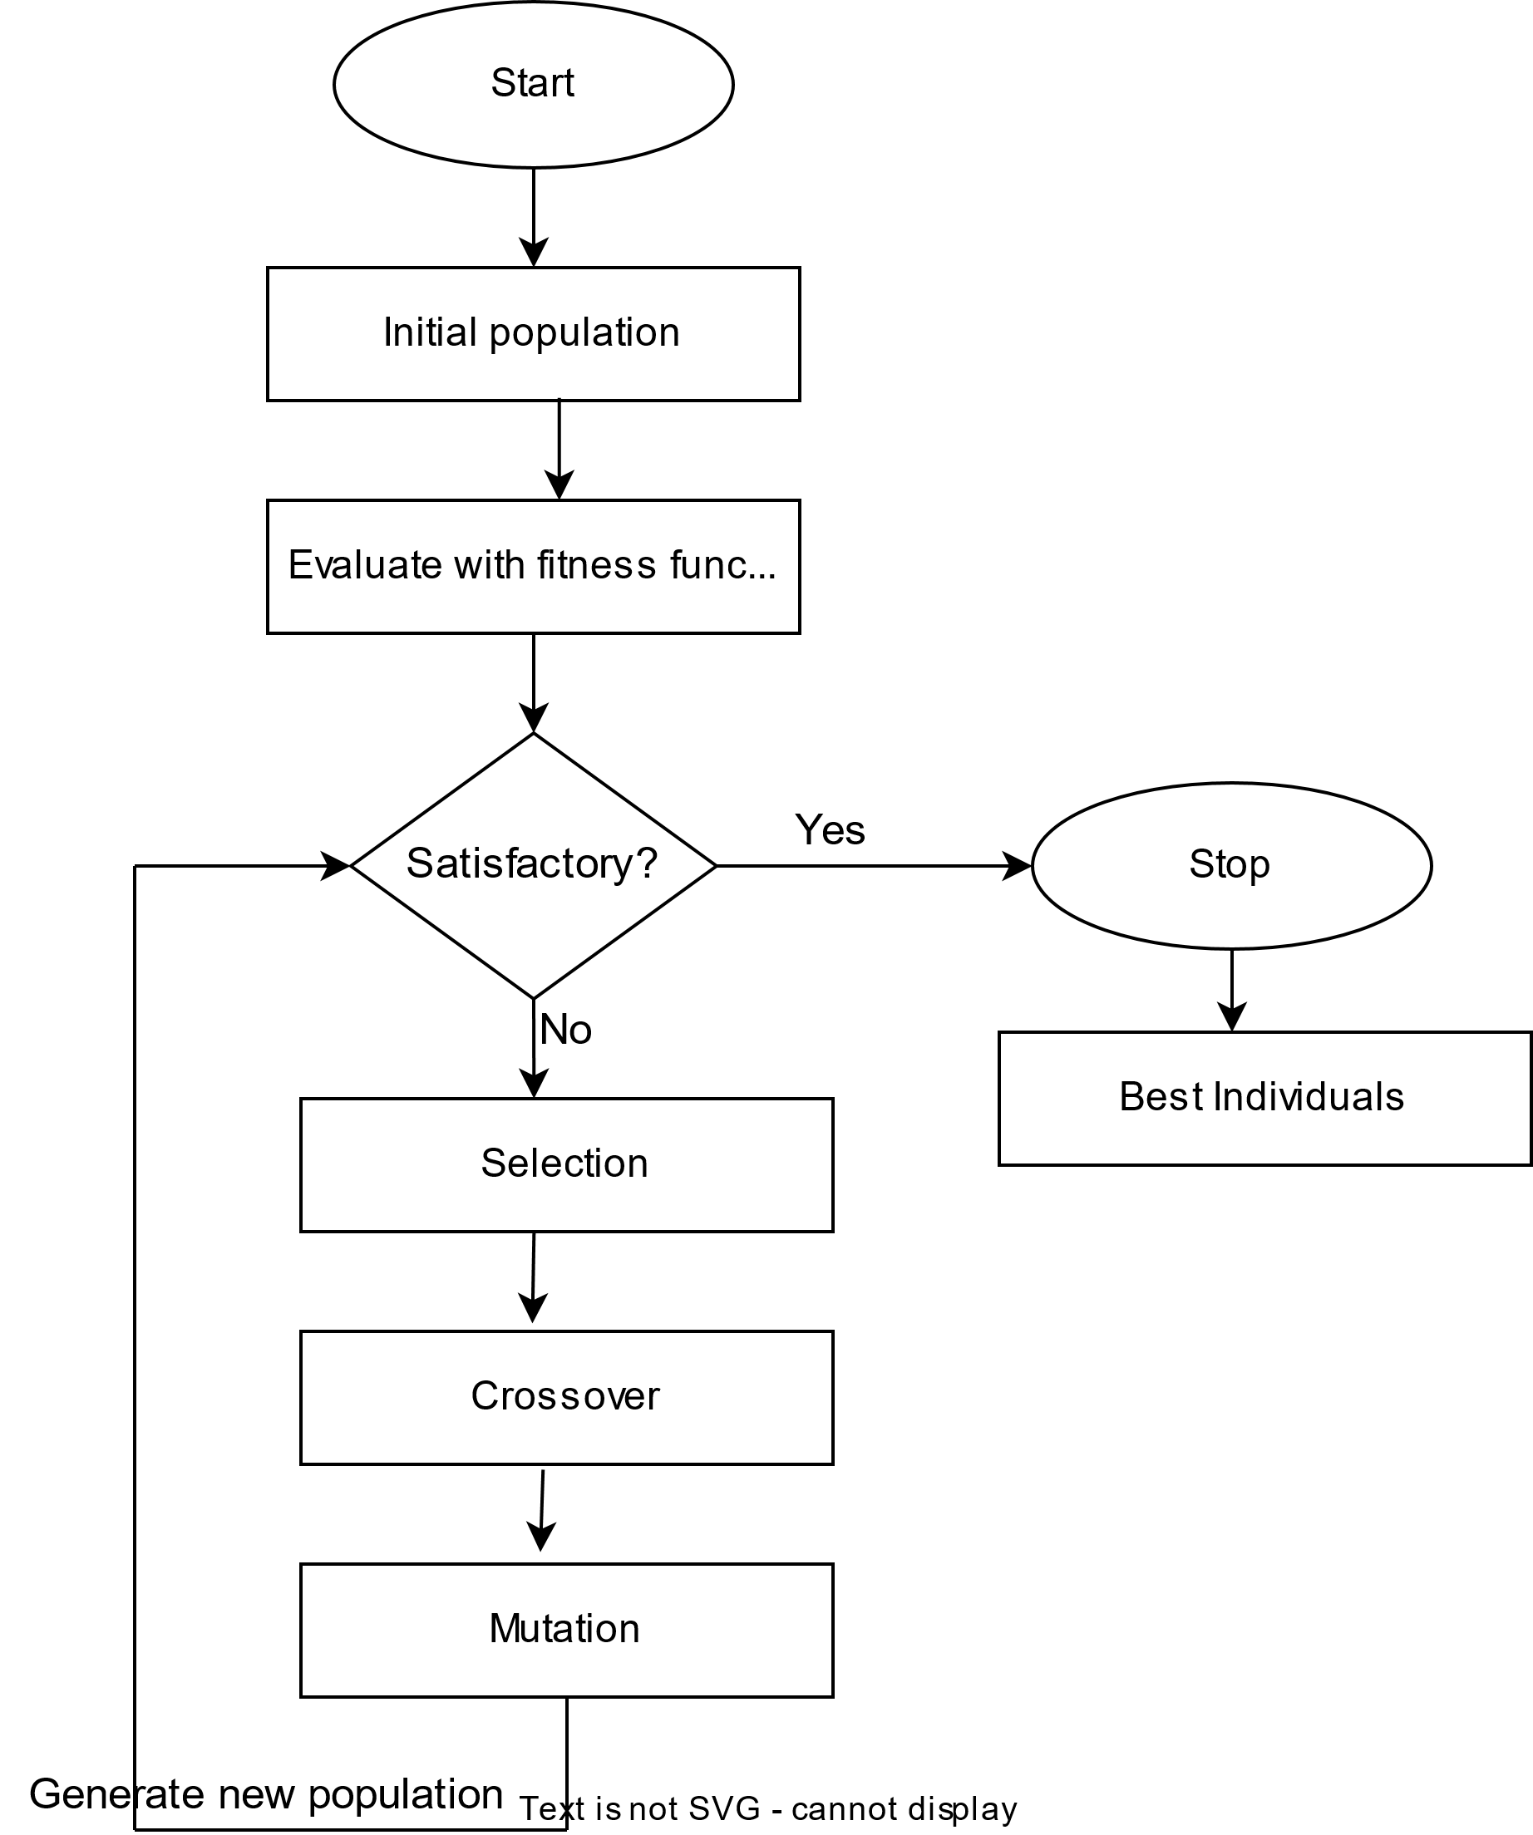

Slide 16
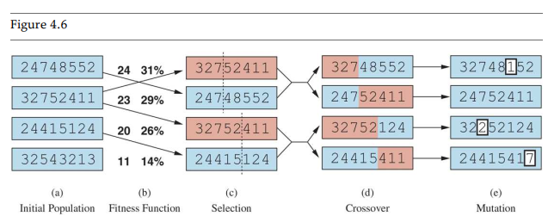
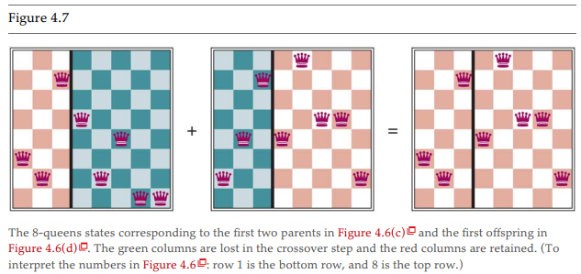
GA for 8^{-Queen Problem}

Slide 17
Adversarial search
competitive environments, in which two or more agents have
conflicting goals, giving rise to adversarial search problems.
MinMax Algorithm
AlphBeta pruning

Slide 18
Game theory
Zero sum game
Zero-sum game is a mathematical representation in game theory and economic theory of a situation that involves two sides, where the result is an advantage for one side and an equivalent loss for the other

Slide 19
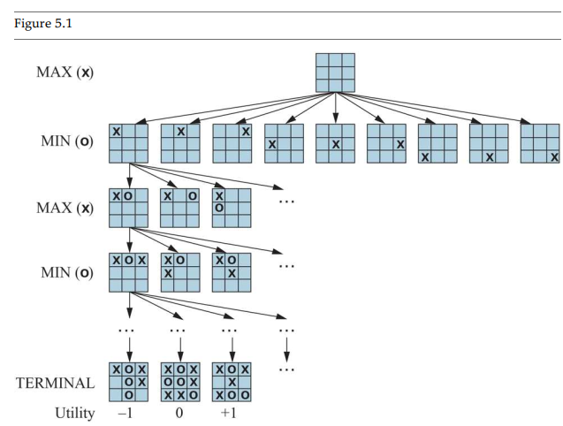
MinMax Algo

Slide 20
For tic-toc-toe
9!=362, 880
Chess 10⁴⁰

Slide 21
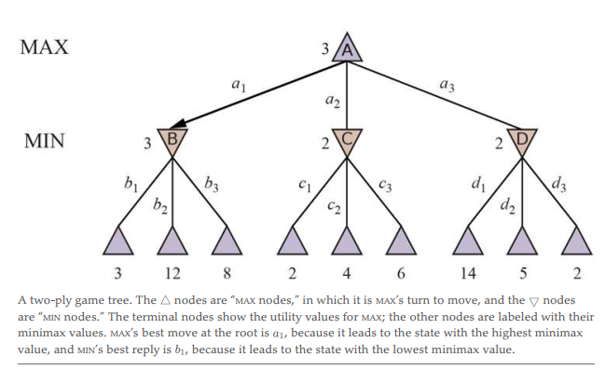
Cont…
Optimal Decisions in Games

Slide 22
Alpha–Beta Pruning
The number of game states is exponential in the depth of the tree.
cut it in half, computing the correct minimax decision without examining every state by pruning.

Slide 23
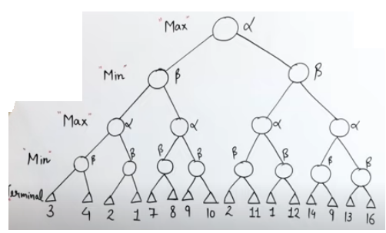
Cont…

Slide 24
Generative Adversarial Network (GAN)
A generative adversarial network (GAN) is a class of machine learning frameworks and a prominent framework for approaching generative AI.^{[1][2]} The concept was initially developed by Ian Goodfellow and his colleagues in June 2014.^{[3]} In a GAN, two neural networks contest with each other in the form of a zero-sum game, where one agent's gain is another agent's loss.

Slide 25
Cont…
Given a training set, this technique learns to generate new data with the same statistics as the training set. For example, a GAN trained on photographs can generate new photographs that look at least superficially authentic to human observers, having many realistic characteristics. Though originally proposed as a form of generative model for unsupervised learning, GANs have also proved useful for semi-supervised learning,^{[4]} fully supervised learning,^{[5]} and reinforcement learning.^{[6]}

Slide 26
Cont…
The core idea of a GAN is based on the "indirect" training through the discriminator, another neural network that can tell how "realistic" the input seems, which itself is also being updated dynamically.^{[7]} This means that the generator is not trained to minimize the distance to a specific image, but rather to fool the discriminator. This enables the model to learn in an unsupervised manner.
GANs are similar to mimicry in evolutionary biology, with an evolutionary arms race between both networks

Slide 27
https://machinelearningmastery.com/impressive-applications-of-generative-adversarial-networks/

